Slide 1
Applied Capstone Project
Model and Prediction of severity of road accidents in Seattle
Elliot Ho
26th September

Slide 2
Introduction and Data Exploration
Data file used is Data_Collisions.csv available on the Capstone Project
This project intends to analyse and process the traffic incidents data in Seattle. The aim of the project is to predict the severity of an accident with the data given like latitude, longitude, weather conditions, junction types and others.
Pre-process the data
Build the machine learning model
Evaluate the model for accuracy

Slide 3
Business Understanding
This data science study is to predict the severity (1 or 2) of a vehicular accident based on already existing data for the Seattle region
Severity of 1 indicates that there was just property damage. Severity of 2 indicates serious injury or fatality
The occurrence of each incident is highly dependent on the location of the accident and the environmental conditions

Slide 4
Business Understanding
Target VARIABLE : severity code (SEVERITYCODE)
Independent variables : VEHCOUNT, SDOT_COLCODE, INATTENTIONIND, UNDERINFL, SPEEDING, WEATHER, JUNCTIONTYPE, ROADCOND, LIGHTCOND.
The project stake holders are the Seattle City corporation for implementation of safety strategies and reduction of fatalities.
Stakeholder groups includes state, federal and local government agencies, non-governmental organisations Car and life Insurance companies, Urgent and Emergency care and other regional authorities

Slide 5
Data Understanding
The Data Set consists of a record of all accidents. Each row corresponds to a single incident. The main features or attributes that are going to form our training set are:
Road Condition
Weather Condition
Driver Inattention
Junction
Car Speeding
No. of people/vehicles involved
light conditions

Slide 6
Data Understanding
'speeding' feature has mostly 'na' values and is not really suitable for the training set
'Location' feature contains the literal address of the accident location and hence is not a suitable attribute for the feature set.
‘Road Conditions' is a categorical value and comprises:
Dry, Wet, Unknown, Ice, Snow/Slush, Other, Standing Water, Sand/Mud/Dirt, Oil
The categorical values for 'Weather' feature are:
Clear, Raining, Overcast, Snowing, Fog/Smog/Smoke, Sleet/Hail/Freezing Rain, Blowing Sand/Dirt, Severe Crosswind, Partly Cloudy
'JUNCTIONTYPE' categorical values:
Mid-Block (not related to intersection), At Intersection (intersection related), Mid-Block (but intersection related), Driveway Junction, At Intersection (but not related to intersection), Ramp Junction,

Slide 7
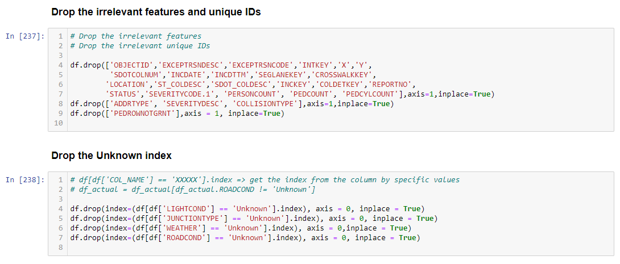
Methodology – Data Cleaning

Slide 8
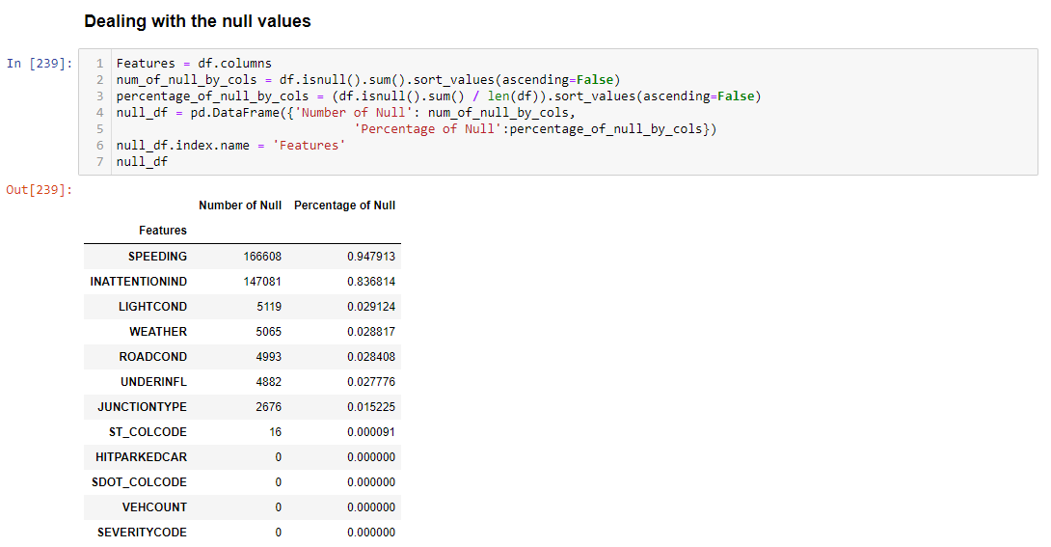
Methodology – Data Cleaning
Dealing with the missing values

Slide 9
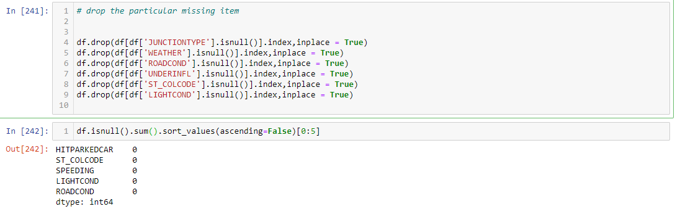
Methodology – Data Cleaning
Dealing with the null values
All the missing and null values are settled down.

Slide 10
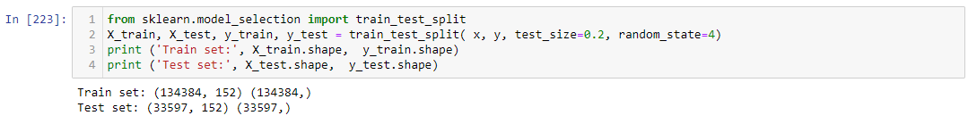
Train and Test set
Before normalizing the data set, we need to balance the data set by using the random under sampling (RUS) method.

Slide 11
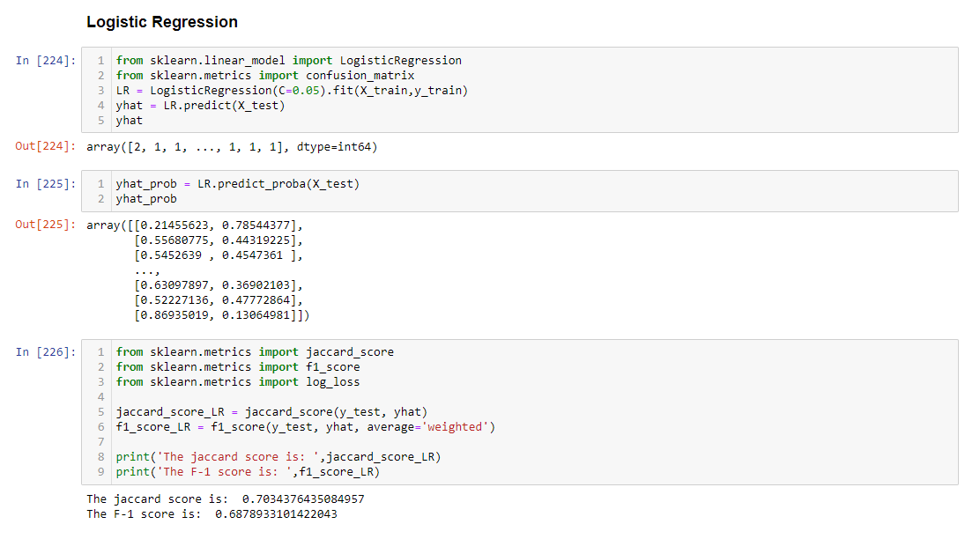
Logistic Regression Algorithm

Slide 12
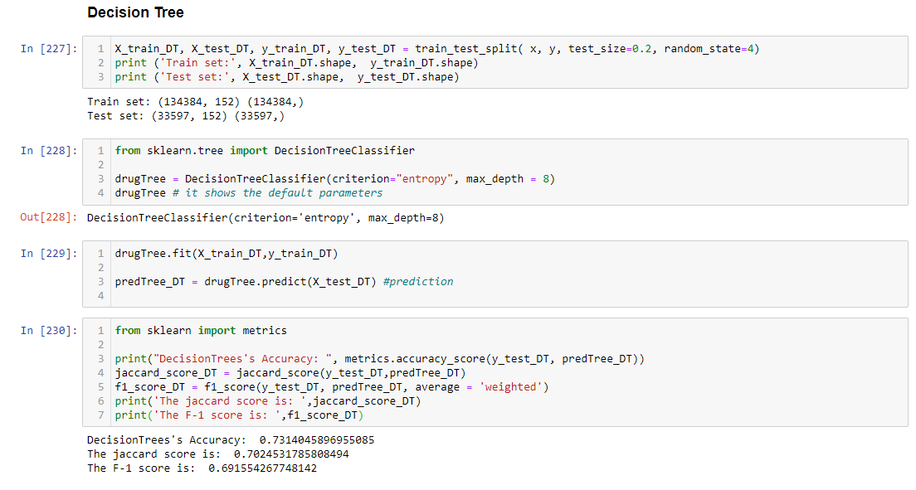
Decision Tree Algorithm

Slide 13
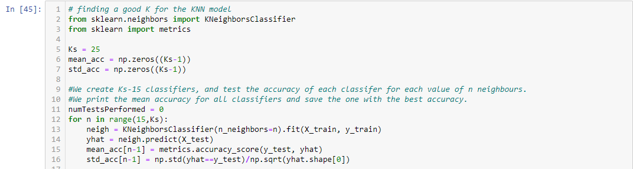
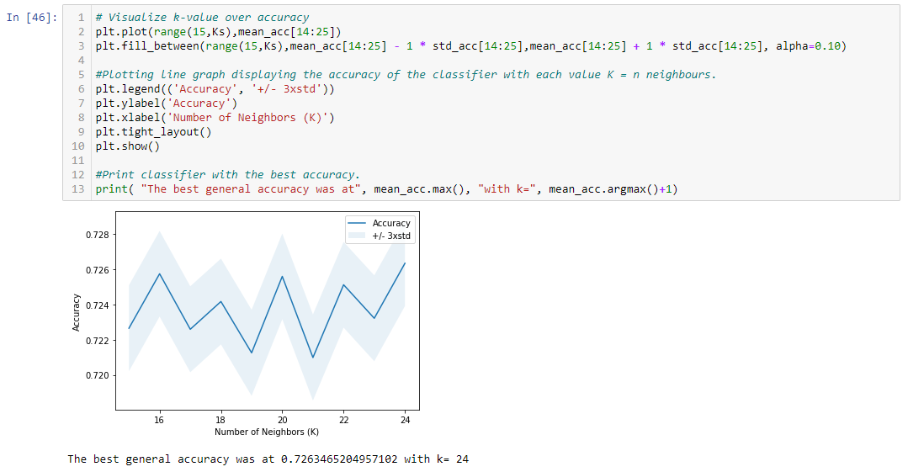
K-Nearest Neighbour Algorithm

Slide 14
K-Nearest Neighbour Algorithm

Slide 15
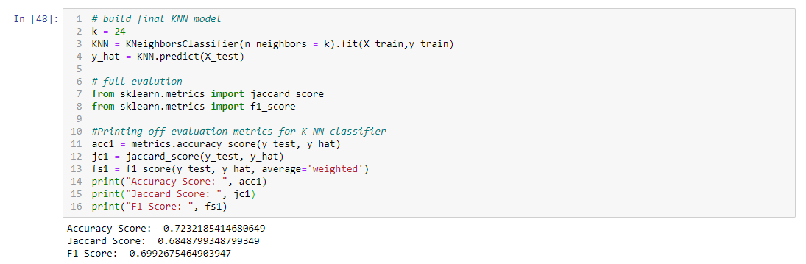
K-Nearest Neighbour Algorithm

Slide 16
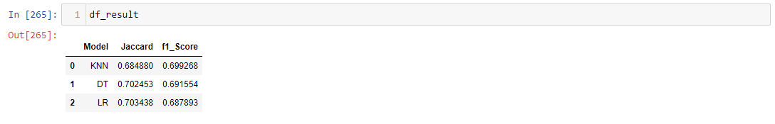
Results
From the above table, we can see that the logistic regression is the best model for this project. And the worst model is KNN.

Slide 17
Conclusion
Data science equips us with a system to predict an outcome before it happens
This is especially very useful in the case of road accidents
Using the data of environment conditions and locations of previous accidents we can now say with a 70% certainty that dry road conditions and mid-block junctions related to intersections cause a higher probability of accidents than any other conditions

